Slide 1
Competitive
Programming
Lesson 5 - Greedy + Ad Hoc
Written by Jason Sun
and Puneet Bhat

Slide 2
1
Greedy
Choosing the best possible choice at every state to lead you to the answer.

Slide 3
Definition
“Greedy algorithms are a class of algorithms that make locally optimal choices at each step with the hope of finding a global optimum solution.”
https://www.geeksforgeeks.org/greedy-algorithms/

Slide 4
Speed?
Since you take choices at face value instead of considering the various possibilities and other states, this usually makes greedy algorithms really fast.

Slide 5
Tips
1
2
3
Since greedy is more about a way of thinking about a problem, and less about just knowing some knowledge to solve a problem, it makes it hard to learn. Aside from practice, there are some tips to keep in mind.
Goal
Problem
Solving
A problem is usually greedy if it wants the best answer
(eg. min or max).
If it can be broken down into subproblems and making locally optimal choices leads to the answer, then it can be solved with greedy.
To solve, usually try to make as many observations as possible, and explore various types of locally optimal choices to check if any are globally optimal.

Slide 6
2
Ad Hoc
A problem that there is no specific technique for. Thus it requires a unique solution made and tailored for the exact problem.

Slide 7
Example
Problem
You were given the faces of an unsolved rubik's cube and needed to output the moves to solve it.
Type
This is ad hoc (assuming that solving a rubik’s cube isn’t common knowledge) because you will have to figure out the steps on solving a rubik's cube, and that isn’t at all related to any competitive programming topics.

Slide 8
Definitions
Think of these two terms as opposites, which makes both easier to understand, given the contrast.
Template
Ad Hoc
Problems that are significantly easier if you already have some similar knowledge.
For example, given a list of 1 million numbers, answer 1 million queries that ask for the sum of a range in the list of numbers. Well, obviously the solution is PSA, so all you do is implement a PSA and you’ve solved the problem. Simple and easy.
Problems that can not be made easier with any previous knowledge.
It can be trained for instead by intuition and practicing skills instead of learning knowledge.
Skills:
Making better observations
Learning how to make notes
Efficient testing of various approaches

Slide 9
3
Examples
Some applications to exercise what you’ve learnt.

Slide 10
#1 - Coin Change
Given a denomination of coins with values {1, 5, 10} (in cents), determine the minimum number of coins needed to make the change for a certain amount of money. All input will be in cents.
What do you think this is? Greedy Ad Hoc Neither
Given your intuition and what you’ve learnt, how would you approach solving this problem?
Sample Input
47
Sample Output
7
Explanation
10 + 10 + 10 + 10 + 5 + 1 + 1
Notes:
Greedy

Slide 11
#1 - Solution
Problem Type: Greedy
Explanation:
We want to use the minimum number of coins possible to come up with a certain amount of money
To do this, we must use a greedy algorithm to solve the problem piece-by-piece
Solution:
We need to continuously subtract the largest number that isn’t greater than our current amount, and keep track of the amount of times we do this
Since 1 is a factor of 5 and 5 is a factor of 10, this means that it is always worth it to use larger numbers as they save you from using repeated smaller numbers to take away the same amount. For example, three 10s make 30, whereas you would need six 5s to make the same amount.
Notes:
Greedy

Slide 12
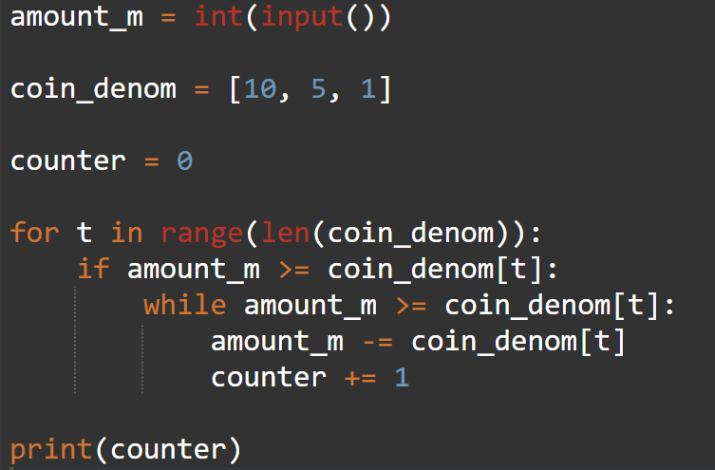
#1 - Sample Code
*Python Solution by Puneet Bhat

Slide 13
#2 - Odd Appearances
Given a natural number N (< 10^6) and N integers, determine the amount of integers that appear an odd number of times. After, print each number that appears an odd number of times, as well as how many times it has appeared from least to most appearances.
It must be noted that all numbers that appear an odd number of times will have unique numbers of appearances.
What do you think this is? Greedy Ad Hoc Neither
Given your intuition and what you’ve learnt, how would you approach solving this problem?
Sample Input:
7 1 3 3 7 7 7 2 2
Sample Output:
2 1 1 7 3
Explanation
The two numbers 1 and 7 both appear an odd number of times, whereas 3 and 2 appear an even number of times. As such, 1 (appeared 1 time) and 7 (appeared 3 times) are outputted.
Notes:
Greedy

Slide 14
#2 - Solution
Problem Type: Ad Hoc
Explanation:
We are trying to find all numbers that have odd frequencies in our given list and output them as mentioned in the problem
Solution:
In this problem, it is ideal to use a map to keep track of the frequencies of each number in the list
We then loop through each number and it’s frequency in the map, storing the numbers that have an odd frequency in a list
Then we sort the list in ascending order based on frequencies and print out each number, in order, in the created list
Note: Sorting the list can be done by using another dictionary, or by simply using a key.
Notes:
Greedy

Slide 15
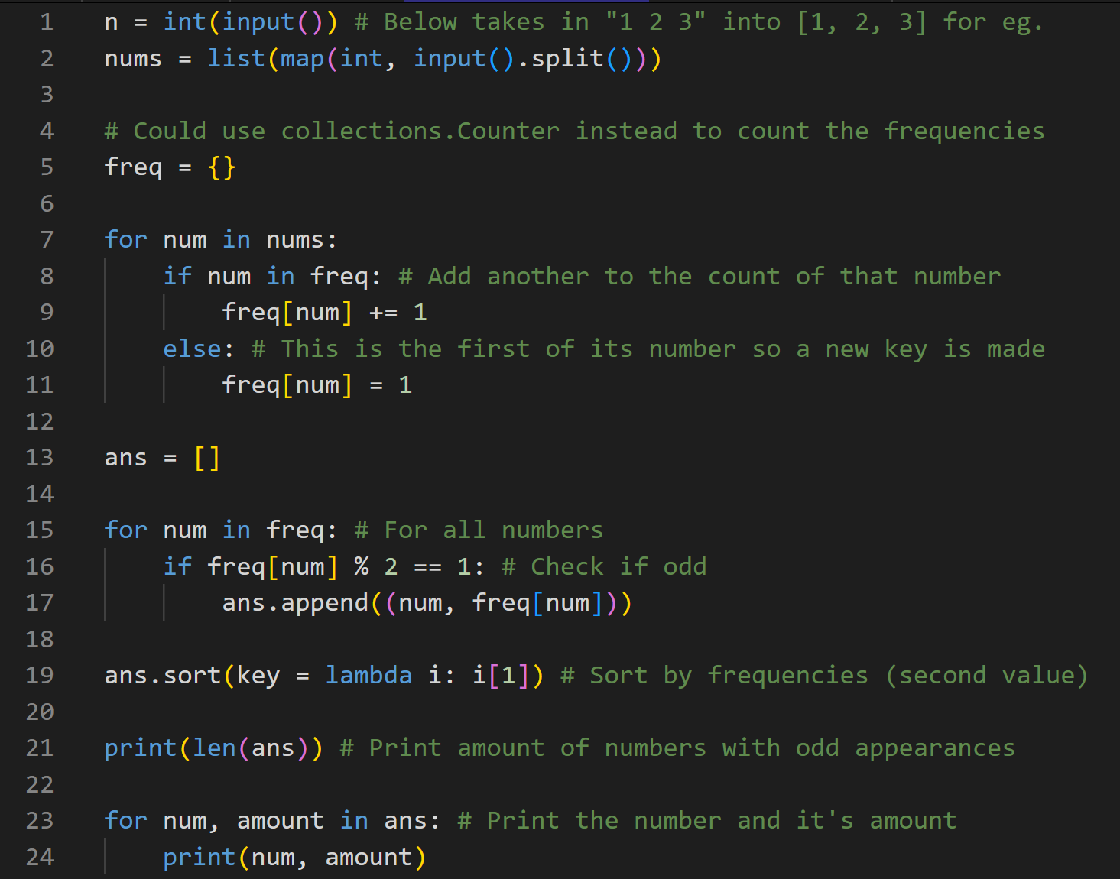
#2 - Sample Code
*Python Solution by Jason Sun

Slide 16
^.^
Practice
If you want to truly improve, practice! Do the homework as well as some DMOJ questions outside of class. It can be a fun hobby!

Slide 17
Homework
Junior
1) Distance - https://dmoj.ca/problem/tle17c6p1
2) Home Row - https://dmoj.ca/problem/dmopc20c5p1
3) CCC '13 J4 - Time on task - https://dmoj.ca/problem/ccc13j4
4) CCC ‘16 S2 - Tandem Bicycle - https://dmoj.ca/problem/ccc16s2
Senior
1) Carol's Carnivorous Plants - https://dmoj.ca/problem/thicc17p1
2) Safe from Rooks - https://dmoj.ca/problem/dwite10c5p2
3) A Typical Codeforces Problem - https://dmoj.ca/problem/tcc1p1

Slide 18
Thanks!
Do you have any questions?
https://github.com/CryoJS/DSA-Handbook

